Slide 1

INVESTMENT STRATEGY 2026
MONACO
January 15, 2026

Slide 2
The bubble is real
EVOLUTION OF THE S&P 500 AND S&P 500 MOMENTUM INDICES SINCE 1997
Outperformance +112%
(22/12/1997 - 24/03/2000)
Outperformance +46%
Since 16/10/2023
The current bubble could potentially go further...
Source : Factset, data as of 31/12/2025. Past performance and volatility are not indicative of future performance and volatility and are not constant over time. In particular, they may be independently affected by changes in exchange rates.

Slide 3



2026: a fiscal year
A wide range of fiscal stimuli will be at work
PERMANENT BUDGET DEFICITS
“Growth booster”:
Subsidies for research, Corporate tax reform, lower energy costs, investment in infrastructure
$2,000 checks to households
Tax cuts and subsidies for households
Source : Macrobond, data as of 31/12/2025. The figures relate to the past years and do not prejudge future results

Slide 4

towards a fed takeover?
Market participants expect a different Fed after J. Powell... but how different?
FED FUNDS RATE FORECAST: A PIVOT TO EXPECT FROM MAY 2026?
“The only thing Scott (Bessent) is blowing it on is the Fed because the Fed, the rates are too high, Scott. If you don’t get it fixed fast, I’m going to fire your ass”
President Donald Trump
Source : Macrobond, data as of 31/12/2025. The figures relate to the past years and do not prejudge future results

Slide 5
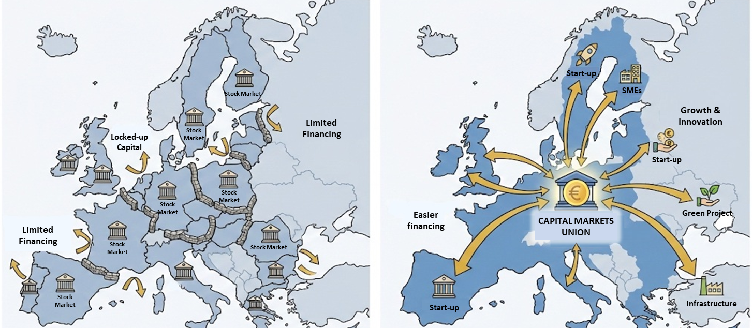
Towards A capital markets union?
The Capital Markets Union will be the cornerstone...
...as F. MERZ pointed out to the Bundestag last October
BUT WHAT WOULD THIS CAPITAL MARKETS UNION LOOK LIKE?
BEFORE: FRAGMENTED MARKETS
AFTER: CAPITAL MARKETS UNION (CMU)

Slide 6
What about the China-US rivalry?
The rivalry is not only about chips and critical raw materials
ELECTRICITY PRODUCTION OVER 40 YEARS
(IN TERAWATTS/HOUR)
ELECTRICITY PRICES IN A SAMPLE OF COUNTRIES
(IN USD PER KILOWATT/HOUR)
Electricity prices in U.S. Dollar per kilowatt-hour
Source : Ember (2025); Energy Institute - Statistical Review of World Energy (2025) data as of 31/12/2025. The figures relate to the past years and do not prejudge future results

Slide 7
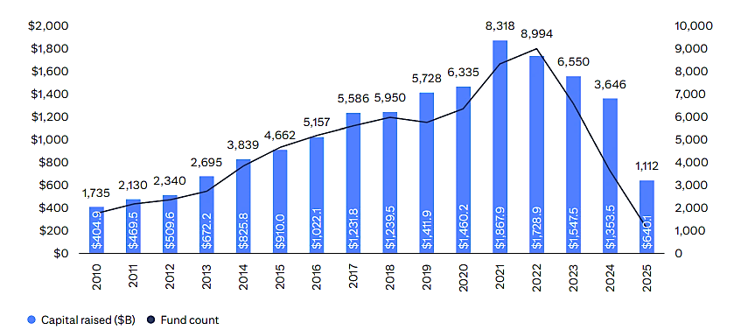
Growing skepticism in the private credit market
Less regulation and increasingly frequent incidents call for caution
PRIVATE CREDIT MARKET ACTIVITY
Source : PitchBook Data, data as of 31/12/2025. The figures relate to the past years and do not prejudge future results

Slide 8
Low risk premiums
Is the juice worth the squeeze?
US MARKET VALUATION METRICS (DATA AS OF 31/12/2025)
Source : Datastream, data as of 31/12/2025. The figures relate to the past years and do not prejudge future results

Slide 9
What about equities?
Bubble + permanent deficit + resilient growth... what should be favoured in 2026?
The market context is encouraging for undervalued assets:
Global small and mid caps, with a focus on Europe
RELATIVE VALUATIONS BETWEEN SMALL AND LARGE CAPS SINCE 2011
Realtive P/E EURO STOXX Small vs EURO STOXX Large
Source : Datastream, data as of 31/12/2025. The figures relate to the past years and do not prejudge future results

Slide 10
king dollar is teetering…
Whatever the scenario, a depreciation of the dollar remains the same conclusion
Scenario #1: Loss of independence for the Fed and stronger interventionism by the White House
The implementation of an expansionary monetary policy to lower interest rates
Scenario #2: The bursting of the AI bubble
AI attracts capital from around the world like a magnet. A significant slowdown would have consequences for economic activity over the medium term and, by extension, lead to a decline of the Dollar.
Scenario #3: Impact of persistent deficits on longer-term rates
Long-term rates are falling due to persistent deficits, and the easing of short-term rates is failing to feed through to the rest of the curve and to the cost of capital in the real economy.

Slide 11
… Gold is dominating headlines
CENTRAL BANK GOLD RESERVES OVER 25 YEARS
Emerging markets are particularly keen to implement a de-dollarization policy
Source : Macrobond, data as of 28/11/2025. The figures relate to the past years and do not prejudge future results

Slide 12
Investment conclusions
KEY TAKEAWAYS
Excessive valuations
Some cracks in the market (Crypto Assets, US Private Assets)
Don’t be too aggressive!
We are in the middle of the AI Bubble… but earnings are broadening
OUR CONVICTIONS
Equities:
Overweight the Big Data, the Resilience themes and European Small Caps
Gold rally might not be over
Keep gold miners
Build positions on anti-momentum assets with sound fundamentals (US Value and Healthcare)
Fixed Income:
Favor:
Emerging Market Debts
Hybrids (both Financials & Corporates)
And Carry strategies

Slide 13
DISCLAIMER
January 2026.
This document has no contractual value, it is designed exclusively for information purposes. Any reproduction or use of all or part of its content is strictly prohibited without the authorisation of the Edmond de Rothschild Group.
The information contained herein should not be construed as an offer or solicitation of a transaction in any jurisdiction in which such offer or solicitation would be unlawful or in which the person making the offer or solicitation is not authorized to act. This document does not constitute and should not be construed as investment advice, tax or legal advice, or a recommendation to buy, sell or continue to hold any investment. The Edmond de Rothschild Group cannot be held liable for any investment or divestment decision taken on the basis of the information contained in this document.
This document has not been reviewed or approved by any regulator in any jurisdiction. The regulations concerning the marketing method of a UCI vary from country to country. The UCIs presented may not be authorized for sale in your country of residence. If you have the slightest doubt about your ability to subscribe to this mutual fund, we invite you to contact your usual advisor.
This document is not intended for citizens or residents of the United States of America or "U.S. Persons" as that term is defined in Regulation S of the U.S. Securities Act of 1933. No bullion product shown herein is permitted for sale under the Securities Act of 1933 or any other applicable U.S. regulations. Therefore, no investment product may be offered or sold, directly or indirectly, in the United States of America to residents and citizens of the United States of America and to U.S. Persons.
The figures, comments, projections and other elements contained in this presentation reflect the Edmond de Rothschild Group's feelings on the markets, their evolution and their regulations, taking into account its expertise, the economic context and the information available to date. They may no longer be relevant on the day the investor becomes aware of them. Consequently, the Edmond de Rothschild Group cannot be held responsible for the quality or accuracy of the economic information and data obtained from third parties.
Any investment involves specific risks. It is therefore recommended that investors ensure that any investment is appropriate to their personal situation by using independent advice if necessary. In addition, they must read the Key Information Document (KID) and/or any other document required by local regulations, provided before any subscription and available in French and English on the website www.edmond-de-rothschild.com "Fund Center" tab or free of charge on request.
Past performance and volatility are not indicative of future performance and volatility and are not constant over time. In particular, they may be independently affected by changes in exchange rates. The performance data does not take into account the commissions and fees received when the units or shares of the UCI are issued and redeemed.
"Edmond de Rothschild Asset Management" or "EdRAM" is the trading name of the asset management entities (including subsidiaries and affiliated entities) of the Edmond de Rothschild Group. This name also refers to the Asset Management division of the Edmond de Rothschild Group
Source of information: Unless otherwise indicated, the sources used in this document are those of the Edmond de Rothschild Group.
This document is issued by Edmond de Rothschild Asset Management (France). You can obtain a summary of investor rights in English and French at the following link: https://www.edmond-de-rothschild.com/media/no2ncu1s/edram-luxembourg-en-investors-rights.pdf.
© Copyright Edmond de Rothschild. All rights reserved.
MANAGEMENT COMPANY AND GLOBAL DISTRIBUTOR
EDMOND DE ROTHSCHILD ASSET MANAGEMENT (FRANCE)
47, rue du Faubourg Saint-Honoré
75401 Paris Cedex 08
Société anonyme à Directoire et Conseil de Surveillance au capital de 11.033.769 euros
Numéro d’agrément AMF GP 04000015
332.652.536 R.C.S. Paris
www.edram.fr

